Slide 1
Lightning Talk
Final Project, Part 1 :

Slide 2
Three Potential Projects Summary
Option 1: The Flow Of Energy
Option 2: We The People
Option 3: The Big Winners
Problem: Utility Reading and Billing industry is transitioning from manually read monthly billing to automated real-time readings.
Question: What type of commercial/residential property owners/mangers are more likely to upgrade their buildings to a n automated system? Who or what drives the upgrade process?
Hypotheses: The owners and building managers that are running Class A high profile building will be more likely to upgrade the energy reading and billing methods. Lower profile buildings with big high profile tenants will also be more likely to upgrade their reading and billing methods.
Problem: The elimination of governmental regulations and resources and privatization.
Question: As public resources and regulation fall in to the hands of public or provide companies will the voice of the citizens no longer matter will the American democratic model continue to function as we know it?
Hypotheses: Once government no longer have a role in regulations and public resources companies with monetary and political influence will have greater impact in public decision not necessarily in the publics interest.
Problem: A high present of American income is spent on the Lottery?
Question: What role does income have on Lottery players? Is there a relationship between lottery player and income.
Hypotheses: The lower the income bracket the family is in the more likely it is to participate in the lottery. The higher the income bracket the less like one will participate in the lottery

Slide 3
Description: The dataset will be from my company’s database. I will by looking at 20 years of data from buildings that are currently being read manually and buildings that have already been converted to automated reading and building method.
Project 1: The Flow Of Energy
Dataset
Account Number | Meter Number | Bill Open Date | Bill Close Date | Present KWh | Prior KWh | Kwh Multiplier | KWh Usage | Present KW | Prior KW | Kw Multiplier | KW Use | Sub Total | Sales Tax | Total Bill
00010 | 000002 | 9/30/2017 | 10/31/2017 | 695586 | 672246 | 1 | 23340 | 35 | 0 | 1 | 35 | 2276.01 | 0 | 2276.01
00010 | 000026 | 9/30/2017 | 10/31/2017 | 2210 | 92947 | 1 | 3087 | 23.8 | 0 | 1 | 7.933 | 301.03 | 0 | 301.03
00021 | 000004 | 9/30/2017 | 10/31/2017 | 88730 | 88730 | 1 | 0 | 0 | 0 | 1 | 0 | 0 | 0 | 0
00030 | 000001 | 9/30/2017 | 10/31/2017 | 58965 | 57817 | 1 | 1148 | 1.55 | 0 | 1 | 1.55 | 111.95 | 0 | 111.95
00040 | 000005 | 9/30/2017 | 10/31/2017 | 32737 | 30281 | 1 | 2456 | 14 | 0 | 1 | 14 | 0 | 0 | 0
00050 | 000006 | 9/30/2017 | 10/31/2017 | 73586 | 71016 | 1 | 2570 | 16 | 0 | 1 | 16 | 0 | 0 | 0
00060 | 000007 | 9/30/2017 | 10/31/2017 | 31455 | 29519 | 1 | 1936 | 6.2 | 0 | 1 | 6.2 | 0 | 0 | 0
00065 | 000008 | 9/30/2017 | 10/31/2017 | 17781 | 17781 | 1 | 0 | 0 | 0 | 1 | 0 | 0 | 0 | 0
00080 | 000009 | 9/30/2017 | 10/31/2017 | 2614 | 2614 | 1 | 0 | 0 | 0 | 1 | 0 | 0 | 0 | 0
Dataset Variables:
Date
KWH Usage
KW Max
Questions:
1. Is the data relevant
2. Is the data connected
3. Is the data accurate
4. Is there enough data to work with

Slide 4

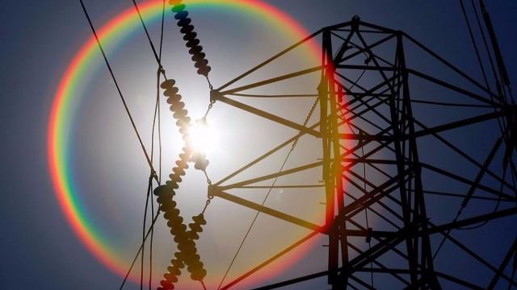
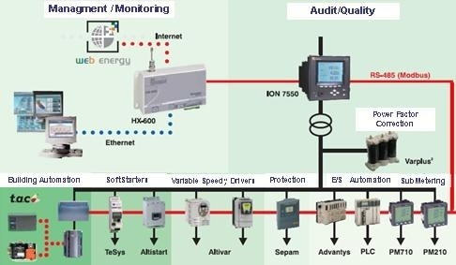
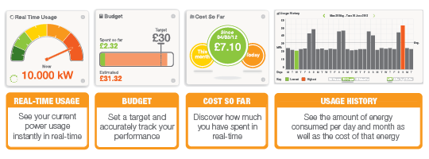
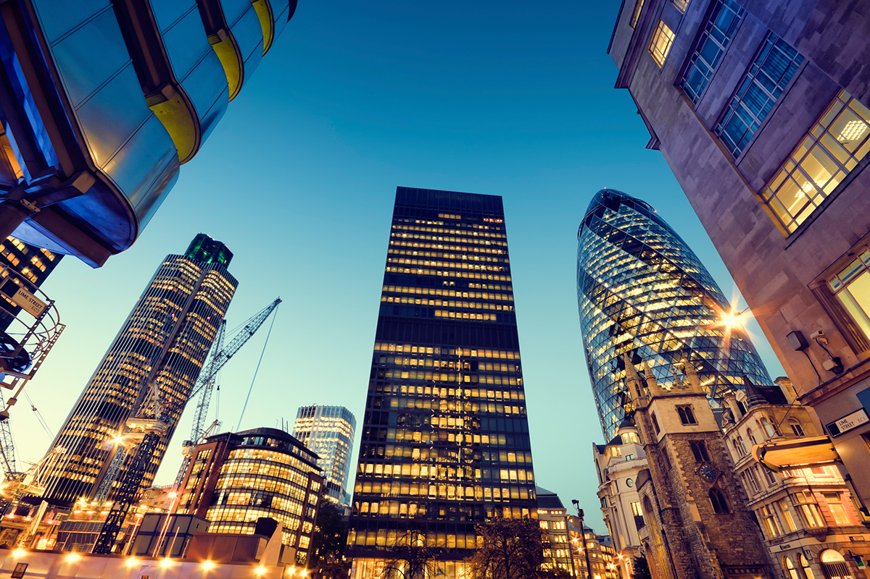
Project 1: The Flow Of Energy
Flow Chart
Energy Creation
Energy Generation and Distribution
Energy Monitoring Devices
Energy Monitoring and Billing
Energy Usage

Slide 5
Description: The dataset will be based on the historical behavior of companies with unfettered access to resources. Most likely it will come from the internet and government sites.
Project 2: We The People
Dataset
Dataset Variables:
Date
KWH Usage
KW Max
Questions:
1. Is the data relevant
2. Is the data connected
3. Is the data accurate
4. Is there enough data to work with

Slide 6
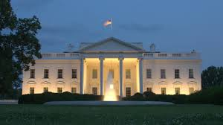

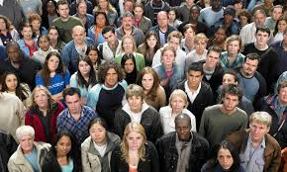


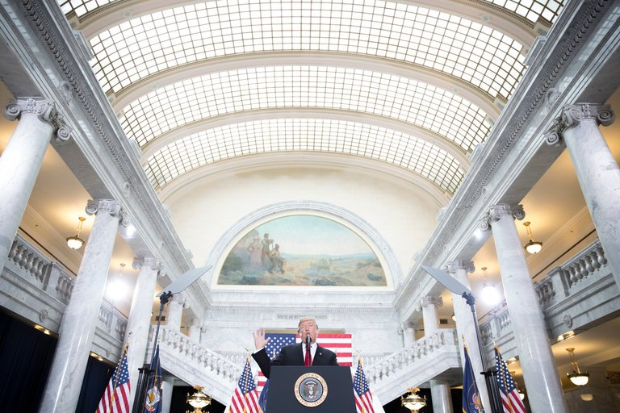
Option 2:
We the People
American Republic / Democracy
Open Fair Financial System
Americans
Regulated Heath Care System
Note Sure
Public Land

Slide 7
Description: The dataset will be based on the historical Lottery data. The dataset will consist of Power Ball, Mega Million and Pick 6 winning numbers. The Data will come from the internet
Project 3: The Big Winner
Dataset
Mega Million
Power Ball
Date | Winning Number | Mega ball
12/8/2017 | 06-37-46-60-70 | 24
12/5/2017 | 14-15-37-42-67 | 22
12/1/2017 | 16-22-40-41-59 | 8
11/28/2017 | 10-17-47-51-61 | 5
11/24/2017 | 16-36-54-61-64 | 22
11/21/2017 | 03-07-22-27-50 | 3
Date | Winning Number | Power ball
12/9/2017 | 25-36-37-55-60 | 6
12/6/2017 | 19-20-50-55-62 | 9
12/2/2017 | 28-30-32-36-58 | 6
11/29/2017 | 24-26-28-59-63 | 16
11/25/2017 | 08-13-27-53-54 | 4
11/22/2017 | 35-37-46-51-61 | 13
Dataset Variables:
Drawing Date
History of Winning Numbers
Birth Dates
?
Questions:
1. Is the data relevant
2. Is the data connected
3. Is the data accurate
4. Is there enough data to work with
Date | Winning Number | Mega ball
12/9/2017 | 06-11-17-25-28-54 | 3
12/6/2017 | 04-21-29-30-31-32 | 6
12/2/2017 | 02-03-26-40-41-55 | 58
11/29/2017 | 05-14-15-16-31-52 | 54
11/25/2017 | 02-14-21-23-38-44 | 10
11/22/2017 | 04-09-28-37-43-48 | 57
New York Lotto

Slide 8
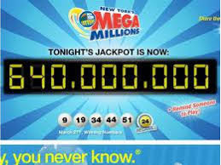
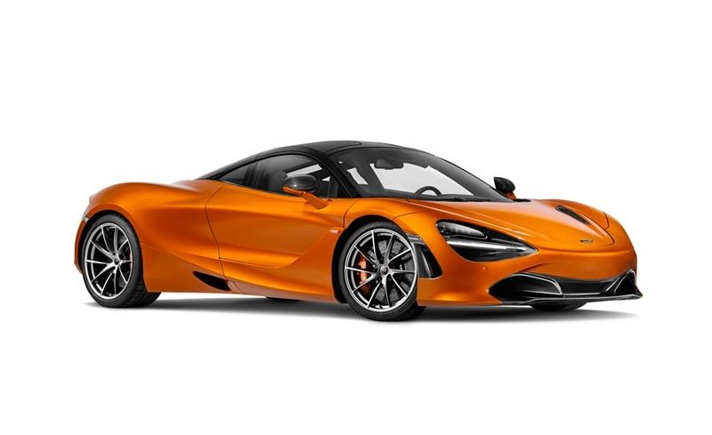
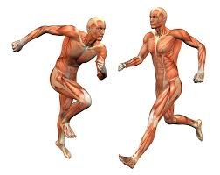

Option 3:
The Big Winners
Big Winner
My New Car
Me Running Out of My Skin
Enjoyment For the Family
The World

